Slide 1

The Project Management and Information Technology Context
Class discussion
ECU Copyright 2015 – CSG 2344 School of Computer and Security Science

Slide 2

What is a system?
Notes:
Sets of interacting components within an environment to fulfil a purpose.
A systems approach describes a holistic and analytical approach to solving complex problems that includes:
A systems philosophy
Systems analysis
Systems management

Slide 3
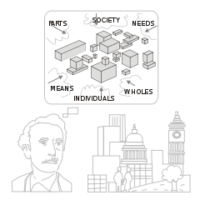
Can you look at a system in isolation?
Why or why not?
ECU Copyright 2015 – CSG 2344 School of Computer and Security Science
Notes:
Systems interact with other systems and their impact upon each other

Slide 4
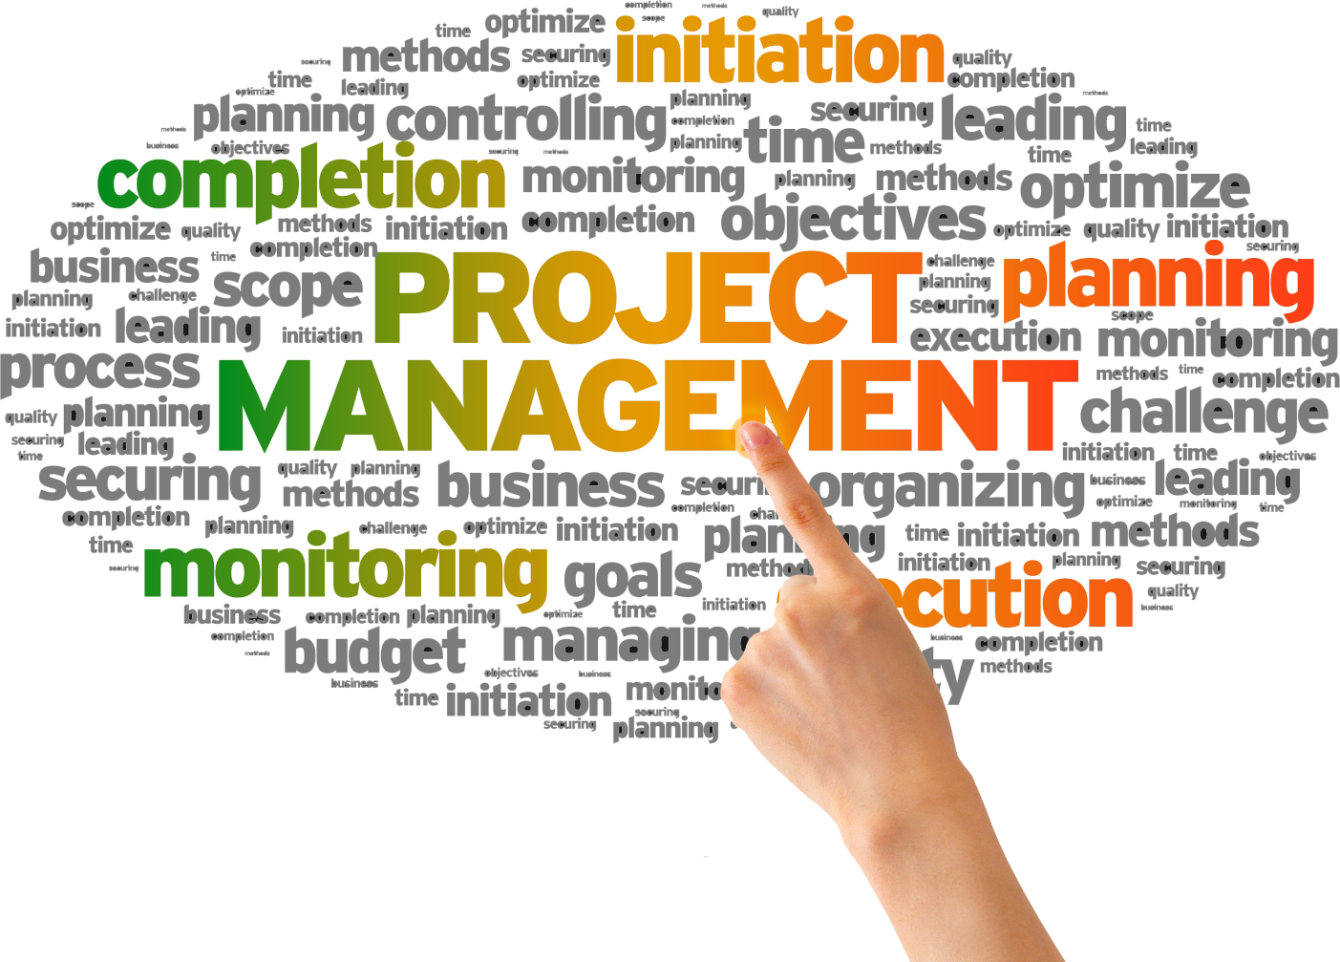
If you are planning an IT project what major issues should you consider?
Planning
Notes:
Business
Financial impact
Customers
Future of the business
Organisation
Structure
Functional – hierarchy
Project – hierarchy
Matrix
Culture
Human resources
Political
symbolic
Technology
New or existing?
Infrastructure
Impact on other applications

Slide 5
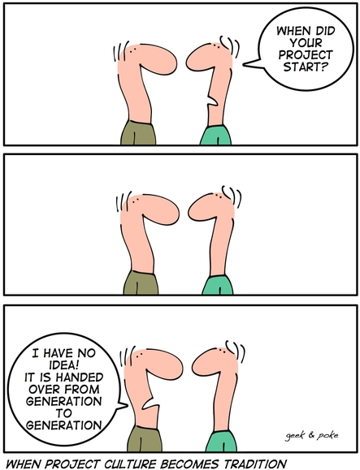
How does the structure/culture of an organisation affect a project?
?
Structure and Culture
Notes:
Authority
Time commitment to project
Budget
Project manager’s role
Project admin

Slide 6
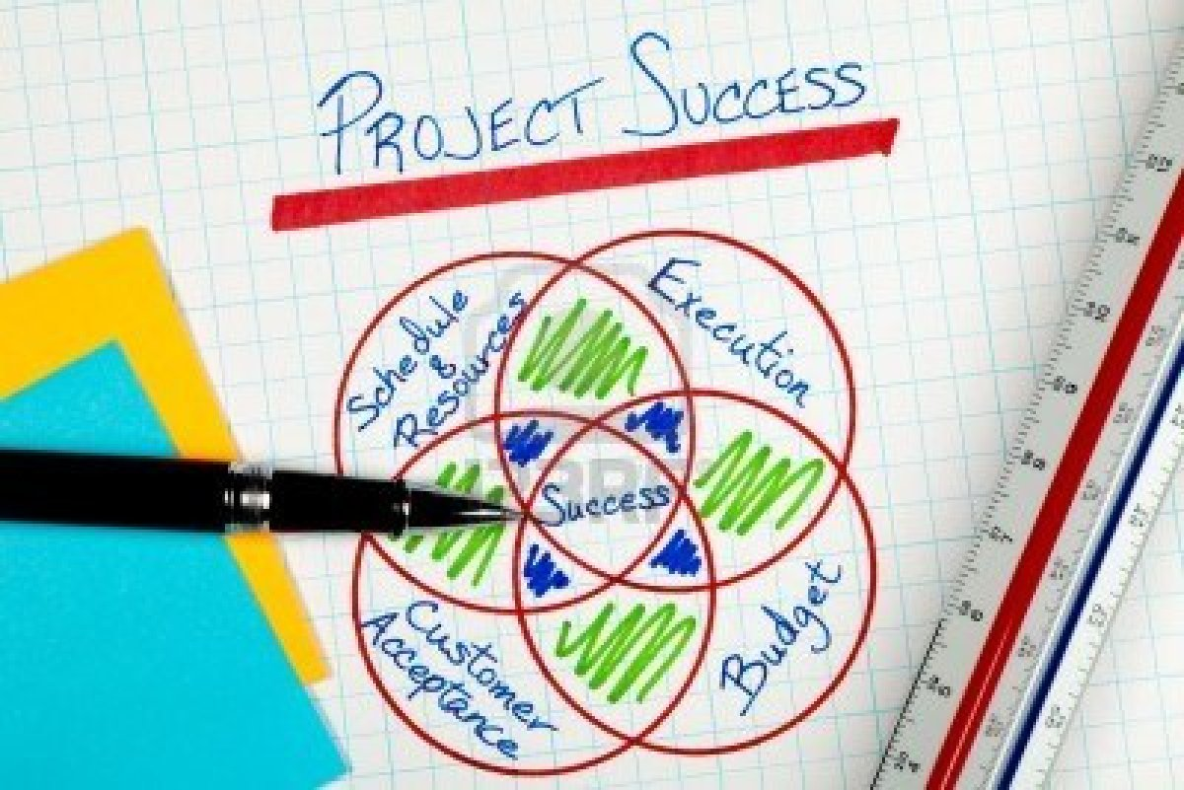
What is most important for the success of a project?
Success attributes
ECU Copyright 2015 – CSG 2344 School of Computer and Security Science
Notes:
executive support
User involvement
Experienced project manager
Clear business objectives
Firm requirements
Formal methodology
Strong understanding of stakeholders
Good governance – best practice
Good organisational standards

Slide 7

What could cause a project to fail?
Failure
Notes:
Lack of:
executive support
User involvement
Experienced project manager
Clear business objectives
Firm requirements
Formal methodology
Strong understanding of stakeholders
No plan
Poorly defined scope
Surprises/non or late disclosure of bad news
Undermining by opponents
Short cuts

Slide 8

Where do you start?
How do you proceed?
Start and Go
ECU Copyright 2015 – CSG 2344 School of Computer and Security Science
Notes:
Split project into phases – project life cycle
Concept
Development
Implementation
Close
evaluate
Identify what is to be delivered in each phase
Assess feasibility:
Technical
Operational
Economic

